Slide 1
Analysis, Design and Development of a Predictive Model to Predict Coronary attorney of Human Body Using Data Mining Algorithm

Slide 2
Presented by
Sabina Yeasmin Anika Roll:1149 Sabrina Akter Chisty Roll:1163 Safayet Hossain Roll:1166
Supervised by Afzal Hossain Asst. Professor Dept. of CSE World University of Bangladesh

Slide 3
Introduction
Nowadays Data Mining is one the most popular and effective technique which is used to find the real solution to each and every problem. This technique extract is hidden predictive and expected data from a large database and all the processes are not through some specific algorithms of Data Mining. Data mining is an important stage of KDD (Knowledge Discovery of Database) which is used for finding potentially important information even form the low level of data. The common purpose of the data mining in medical science is to diagnose and create the predictive model which can predict the specific outcome of any problems of medical science by analysis the large data set.
Heart Disease and Coronary Attorney is already a hot topic all over the world because it accounts to be the most leading cause of death worldwide. A Coronary Attorney is the death of a segment of heart muscle caused by a loss of blood supply. The blood is usually cut off when an artery supplying the heart muscle is blocked by a blood clot. Coronary Attorney called another name of fear and death everywhere and Heart Diseases are truly responsible for this.

Slide 4
Introduction(Cont.)
The people of low income and developing countries are mostly the patient of Heart Diseases. Here male and female both have the same chance percentage of having Heart disease who are the aged within 40-65. The prediction for Heart Disease is possible even though the prediction of Coronary Attorney is a really complex task for medical practitioners because it requires both experience and knowledge to predict. Feelings of pressure, tightness, pain, squeezing, or aching in the chest or arms that spread to the neck, jaw, or back can be a sign that a person is having a heart attack. A perfect predictive model which would contain accurate and effective attribute is the only to predict both Heart Disease and Heart Attack.
A predictive model is the only possible way to predict Heart Disease and Coronary Attorney. In predictive model researchers use Data Mining technique which involves attribute or variables in the data set to find an unknown and future state values of other values or attributes.

Slide 5
Introduction(Cont.)
Here researchers insert patient’s data as input which is compared by a large amount of past analyzed data and the output shows the current state or probability of having heart disease of that patient. The main purpose is to use past values of large numbers to consider future values.
In this research, the authors have designed and developed a predictive model to predict Heart Disease using J48 and Naïve Bayes algorithms which works through Data Mining technique. To conduct the research work the authors collected some real data of heart-related disease from several hospitals, doctors, and technician who have engaged with their job. After creating this model authors checked performance accuracy of the output and also ensured that it’s able to perform as a perfect predictive model which would help not only for medical practitioners but also for normal people by decreasing their both money and time.

Slide 6
Objectives
To develop a predictive model to predict the coronary attorney of human body.
To design a classification model and this would help the users with appropriate outcomes.

Slide 7
Justification of study
The number of heart patients increasing day by day all over the world and it is very difficult to analyze lots of patient’s data manually for medical practitioners. So author’s design a predictive model which will save both time and cost of diagnose. In this research, the authors analyzed all the symptom of the patients and worked with the maximum number of attributes in the expectation of getting an accurate outcome.

Slide 8
Scope of study
A Coronary Attorney is the death of a segment of heart muscle caused by a loss of blood supply. The authors formed a predictive model which help the doctors to unroll the accurate result through analyzed the test reports and minimized their workload. It will help the doctors to know the probability of the coronary attorney of the patient without wasting their important time to analyze the symptoms.

Slide 9
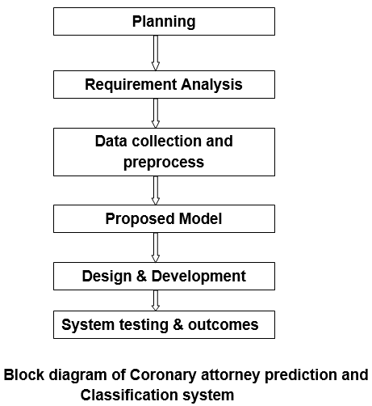
Methodology

Slide 10
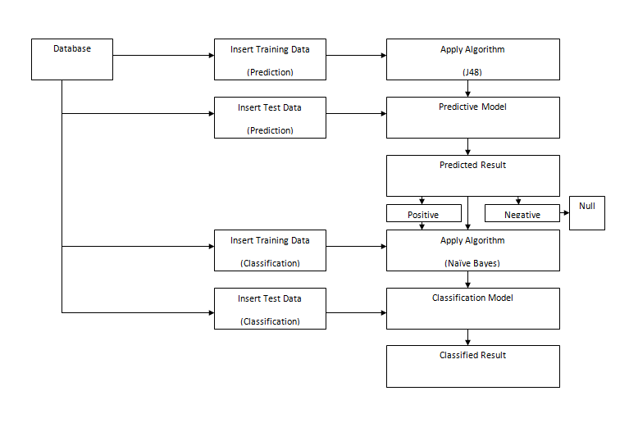
System Design

Slide 11
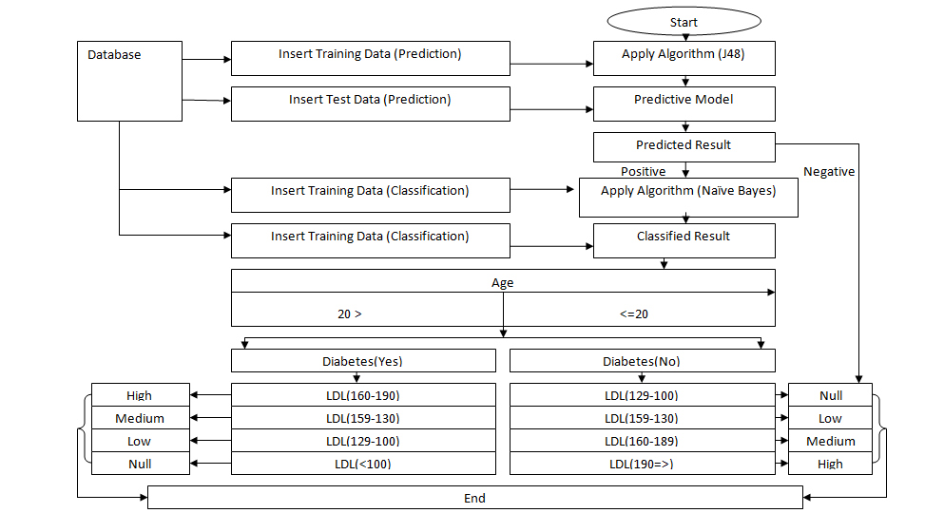
Proposed for prediction and classification system of Coronary Attorney

Slide 12
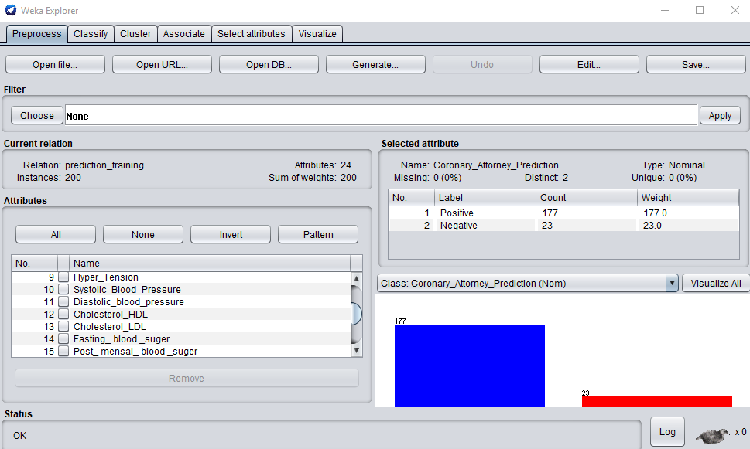
Load data into WEKA

Slide 13
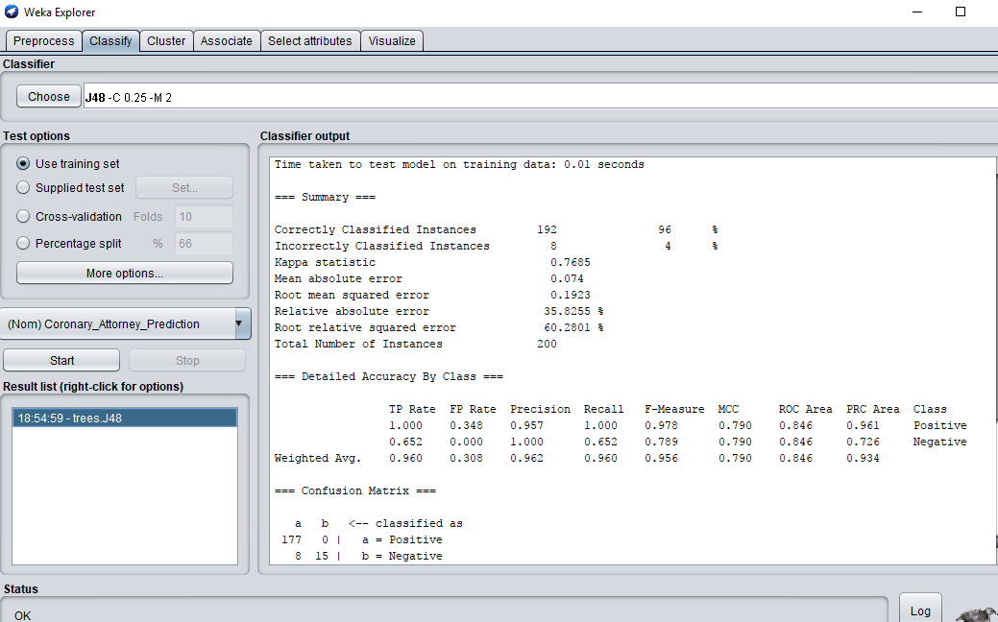
Training data results gained by j48

Slide 14
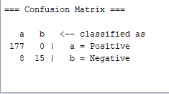
Confusion matrix of Training data results gained by j48

Slide 15
Graphical view of training data results gained by j48
Prediction result | Total Data:200
Coronary Attorney Prediction(Yes) | 177
Coronary Attorney Prediction(No) | 15

Slide 16
Graphical view of Test data results gained by j48
Prediction result | Total Data:50
Coronary Attorney Prediction(Yes) | 47
Coronary Attorney Prediction(No) | 2

Slide 17
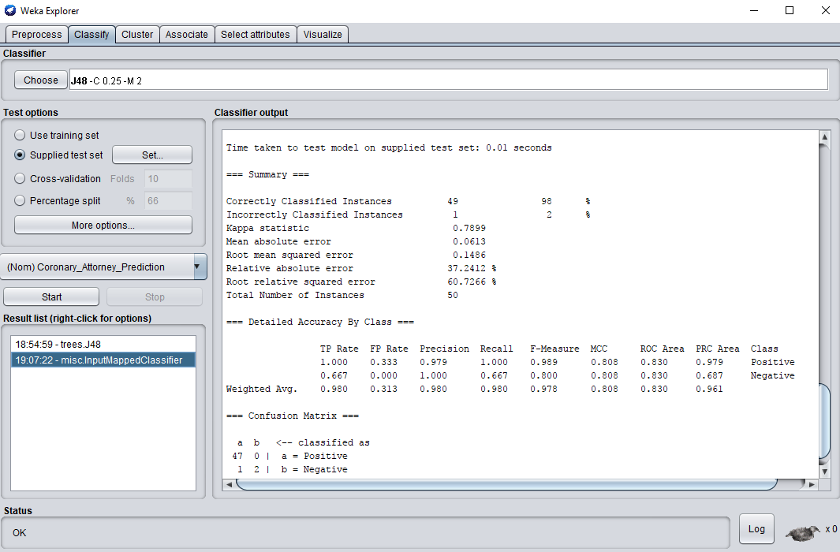
Test data results gained by j48.

Slide 18
Accuracy of Coronary Attorney gained by j48
Result | Accuracy rate
Correct accuracy | 98%
Incorrect accuracy | 2%

Slide 19
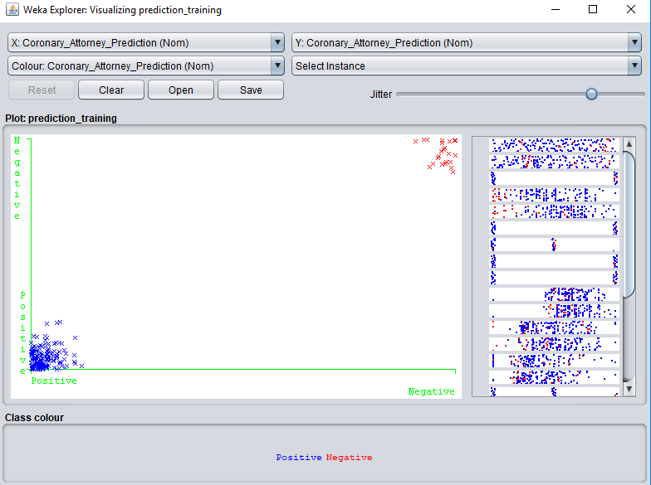
Prediction of Coronary Attorney after applying technique

Slide 20
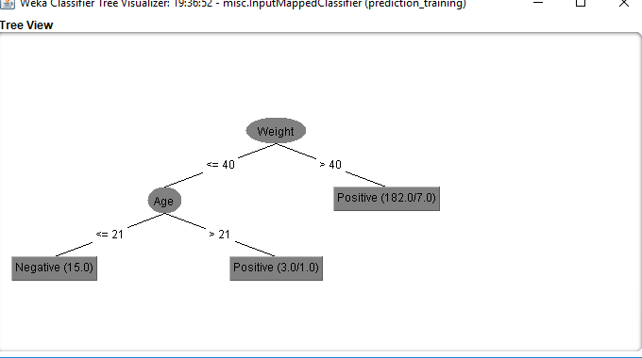
Tree visualization on Prediction of Coronary Attorney After Applying Algorithm

Slide 21
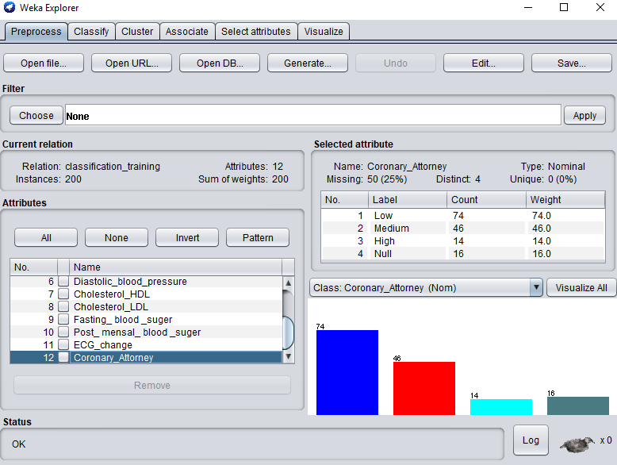
Load Data into WEKA for Classification

Slide 22
Graphical view of Training data result gained by Naïve Bayes
Classifying the level of coronary attorney | Total data:150
High | 11
Medium | 39
Low | 68
Null | 14

Slide 23
Graphical view of Test data result gained by Naïve Bayes
Classifying the level of coronary attorney | Total data:100
High | 41
Medium | 15
Low | 11
Null | 12

Slide 24
Accuracy level of Coronary Attorney gained by Naïve Bayes
Result | Accuracy rate
Correct accuracy | 79%
Incorrect accuracy | 21%

Slide 25
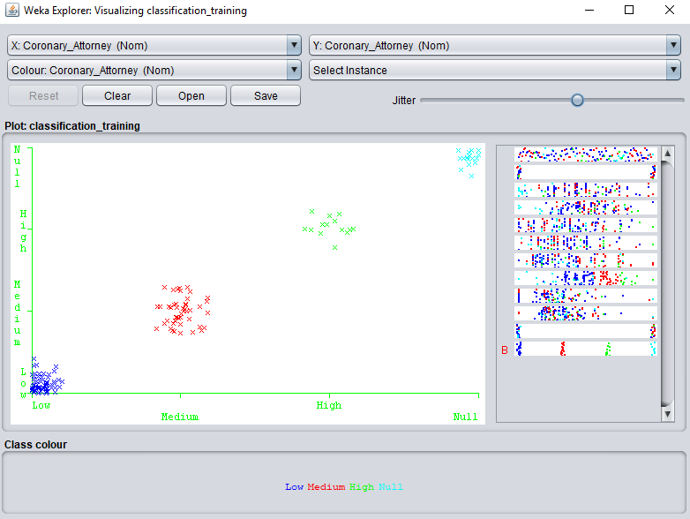
Classification of Coronary Attorney after applying technique

Slide 26
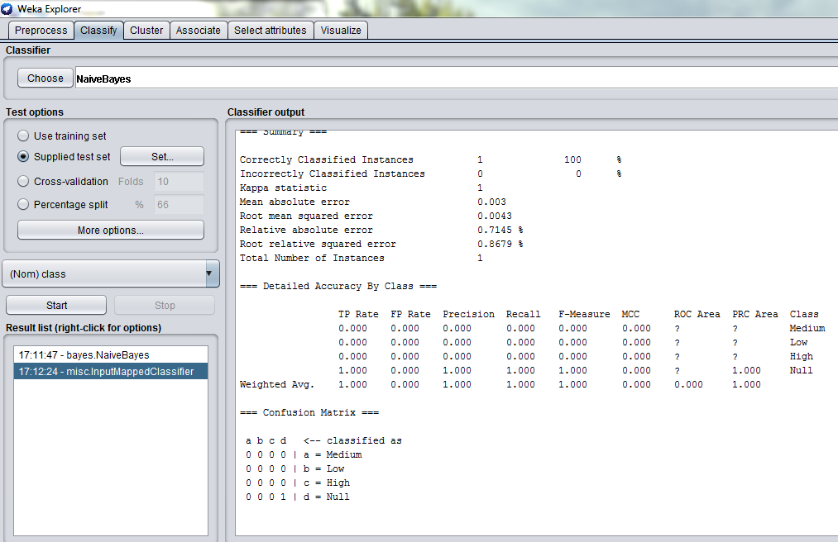
Single patient test data result for classifying the level of Coronary Attorney

Slide 27
Conclusion
This research work has introduced a way to predict and classify coronary attorney of medical patients by creating predictive and classification model .Researchers collected real data of heart patients from Medicals on the basis of preselected attributes and used those data for creating both predictive and classification model .This model is capable to predict the probability of Coronary Attorney of human body and which was the main purpose of this research work. Authors used two data mining techniques, j48 and Naïve Bayes in this research.J48 used for design a predictive model which shows the probability of coronary attorney of a patient and Naïve Bayes for classification model which show probability level of coronary attorney of a patient and both of the model help user with appropriate outcomes .

Slide 28
Limitations
In this research authors worked with lots of test reports, physical condition and habit of a patent but here patients will not be able to know the exact reason which was responsible for coronary attorney.
Here authors also didn’t create any sector in this system where patients could know about the treatment or guideline of each probable stage of coronary attorney.

Slide 29
Future Work
In future authors will upgrade their system by adding multiple features. The system will help patient to know about the actual reason of coronary attorney in his body and the system will also suggest the treatment procedure, medicine and guideline on the basis of each probable stage of coronary attorney.

